Slide 1

Exploring Sentiment Analysis in Customer Reviews Using NLP
Worked by:
T.Prem Kumar Reddy(192211087)
S.Kaladhar Reddy(192211412)
L.Pradeepthi(192211438)
Guided by:
Dr.k.v.kanimozhi
Theory of computing
Saveetha school of engineering

Slide 2
Abstract:
Sentiment analysis has become a vital tool for deciphering insights from customer reviews, enabling businesses to grasp customer sentiments and preferences effectively. This paper delves into the utilization of Natural Language Processing (NLP) techniques for sentiment analysis in customer reviews.
It commences with an overview of sentiment analysis and its importance in interpreting customer feedback. The discussion extends to various NLP methodologies commonly utilized for sentiment analysis, encompassing lexicon-based approaches, machine learning algorithms, and deep learning models.
The paper addresses challenges inherent in sentiment analysis, such as interpreting sarcasm, irony, and context-specific language.
Additionally, it underscores the significance of preprocessing techniques, feature extraction, and model evaluation in attaining precise sentiment analysis outcomes

Slide 3
Introduction:
In today's digital age, where online platforms are central to consumer research and purchasing decisions, customer reviews hold immense sway over brand perceptions and buying behavior. Yet, the sheer volume of textual data available on the internet poses a significant challenge for businesses attempting to glean insights manually from this feedback. This is where Natural Language Processing (NLP) and sentiment analysis come into play. Sentiment analysis, a specialized branch of NLP, utilizes computational techniques to identify, extract, and measure the sentiment conveyed in text data. By employing machine learning algorithms and linguistic analysis, sentiment analysis enables businesses to systematically classify opinions as positive, negative, or neutral. This analytical process offers invaluable insights into customer attitudes and emotions, empowering organizations to gain a deeper understanding of their audience and customize their strategies accordingly.

Slide 4

Main objectives:
Understanding Customer Sentiment
Identifying Positive and Negative Feedback
Improving Customer Satisfaction
Enhancing Product Development
Automating Review Processing
Personalizing Customer Interactions
Predicting Trends
Research and Academic Purposes

Slide 5
Existing system:
Data Collection: Customer reviews are collected from various sources such as e-commerce websites, social media platforms, or dedicated review platforms.
Preprocessing: The collected text data undergoes preprocessing steps like tokenization, removing stop words, stemming or lemmatization, and handling special characters or emojis.
Feature Extraction: Features are extracted from the preprocessed text data to represent the information in a format suitable for machine learning algorithms. This can involve techniques like Bag-of-Words, TF-IDF (Term Frequency-Inverse Document Frequency), or word embeddings like Word2Vec or GloVe.
Model Building: Machine learning models are trained on the extracted features to classify the sentiment of the reviews. Commonly used models include Support Vector Machines (SVM), Naive Bayes, Logistic Regression, or more advanced models like Recurrent Neural Networks (RNNs) or Transformers.

Slide 6
Proposed System:
Sentiment analysis plays a crucial role in deciphering the complex landscape of customer feedback, providing invaluable insights into consumer perceptions, preferences, and satisfaction levels.
In today's digital age, where online reviews wield substantial influence over consumer behavior and brand reputation, the ability to extract sentiments from vast volumes of textual data has become essential for businesses aiming to remain responsive to their customers' needs. Natural Language Processing (NLP) serves as the fundamental framework for sentiment analysis, empowering machines to comprehend, interpret, and extract meaning from human language.
Leveraging NLP techniques, businesses can tap into the rich information embedded within customer reviews, enabling them to make informed decisions, refine products and services, and foster stronger customer relationships.

Slide 7
Implementation:
Implementing sentiment analysis in customer reviews using natural language processing (NLP) involves several key steps. Firstly, the raw text data from customer reviews needs to be collected and preprocessed. This preprocessing step typically involves tasks such as removing punctuation, tokenization, removing stop words, and stemming or lemmatization to normalize the text data.
Once the text data is preprocessed, the next step is to extract features from the text that can be used as input to machine learning algorithms. Common feature extraction techniques include bag-of-words, TF-IDF (Term Frequency-Inverse Document Frequency), and word embeddings such as Word2Vec or GloVe. These techniques represent the text data in a numerical format that machine learning algorithms can understand.

Slide 8
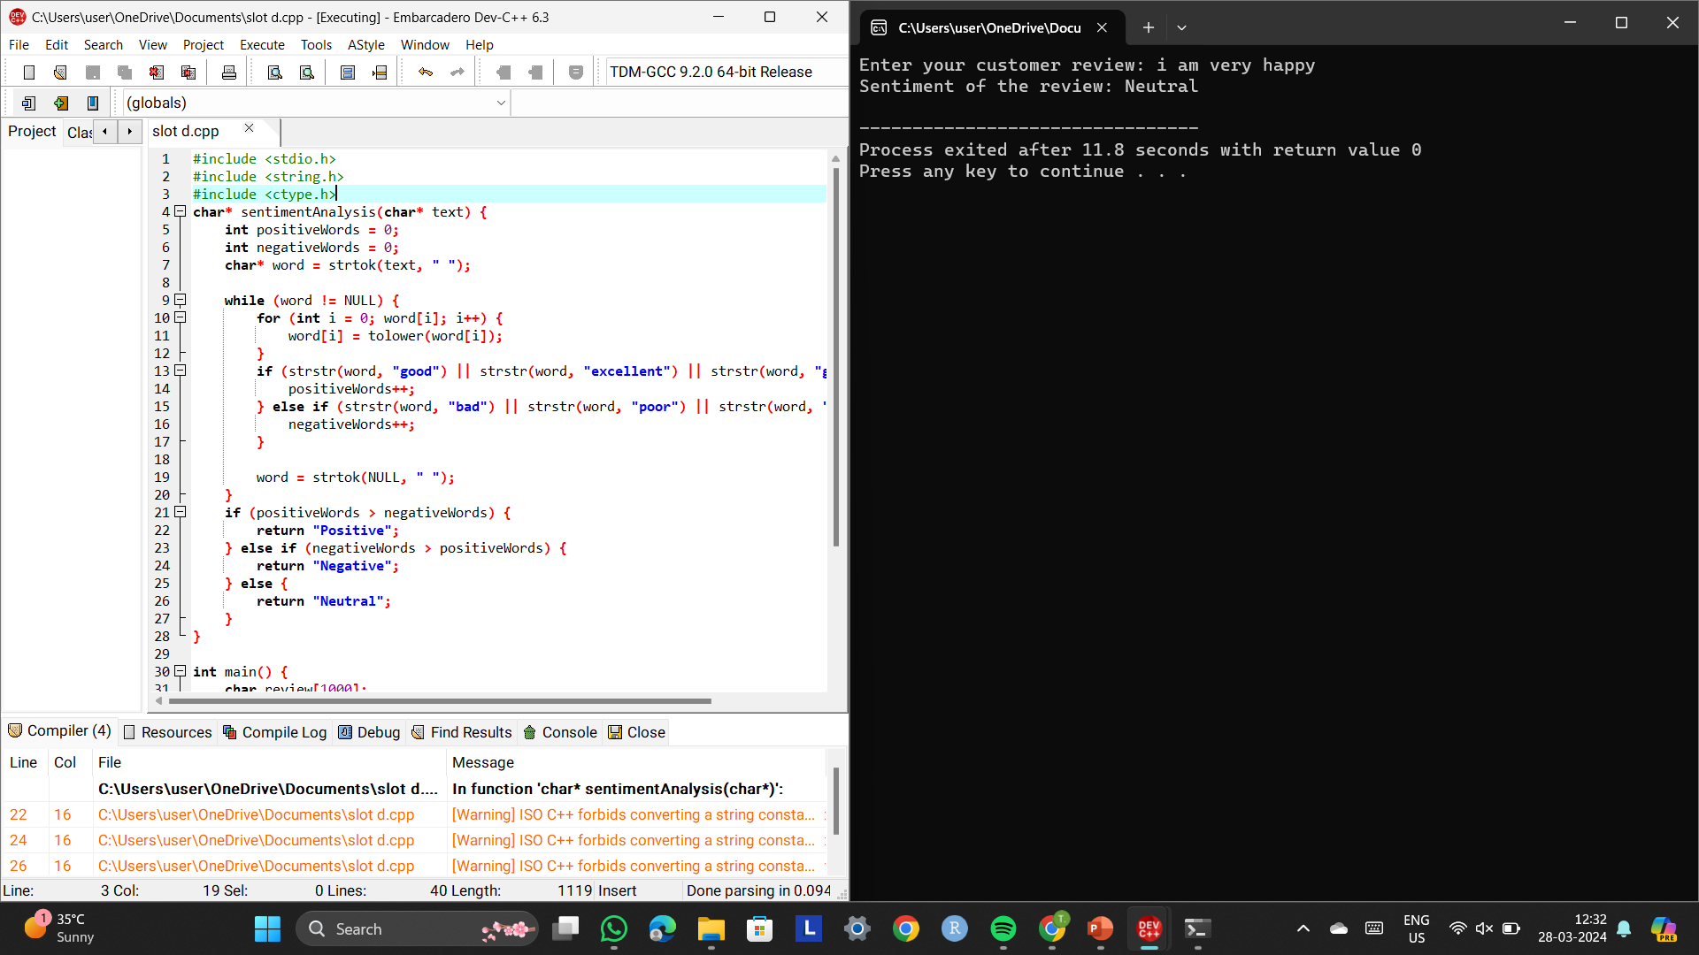
Coding:

Slide 9
Future scope:
The future potential of exploring sentiment analysis in customer reviews using Natural Language Processing (NLP) appears vast and promising. With advancing technology, there's an opportunity for more refined algorithms and models capable of accurately interpreting and analyzing customer sentiments with greater precision.
One area worth exploring further is the incorporation of deep learning techniques like recurrent neural networks (RNNs) and transformers to better capture contextual nuances and semantic meanings within reviews. Additionally, there's a need for enhancements in multilingual sentiment analysis to better serve diverse customer demographics and global markets.
Moreover, integrating aspects of aspect-based sentiment analysis (ABSA) could refine sentiment classification by pinpointing specific features or aspects of products/services influencing customer opinions. Another avenue with potential is the fusion of multimodal data such as text, images, and audio to gain a more comprehensive understanding of customer feedback across various platforms.

Slide 10
Conclusion:
The utilization of Natural Language Processing (NLP) for sentiment analysis in customer reviews presents a valuable tool for businesses seeking to understand customer opinions and preferences.
Through the extraction of sentiments from textual data, NLP enables companies to gain insights into customer satisfaction, identify areas for improvement, and make data-driven decisions to enhance products or services.
However, it's essential to recognize the limitations of sentiment analysis, such as its dependency on the quality of data and the challenges of accurately interpreting nuanced human emotions.
As businesses continue to harness the power of NLP-driven sentiment analysis, they stand to benefit from a deeper understanding of customer sentiment, ultimately leading to enhanced customer experiences and increased competitiveness in the market.

Slide 11


